Slide 1
Fundamentals of CRE
Chemical Reaction Engineering
By
Dr Salah N. Farhan
Senior lecturer. Chem. Eng. Dept.
College of Engineering
University of Diyala
Salah N. Farhan College of Engineering Diyala University

Slide 2
Fundamentals of CRE
Chapter 2: Conversion and Reactor Sizing
Learning Resources
Learning Resources
Summary Notes
  Conversion
  Design Equations
  Reactor Sizing
  Numerical Evaluation of Integrals
  Reactors in Series
  Space Time
  Useful Links
Salah N. Farhan College of Engineering Diyala University

Slide 3





Fundamentals of CRE
Consider the general equation
The basis of calculation is always the limiting reactant. We will choose A as our basis of calculation
and divide through by the stoichiometric coefficient to put everything on the basis of "per mole of A".
The conversion X of species A in a reaction is equal to the number of moles of A reacted per mole of A fed.
Conversion | top
Batch | Flow
Salah N. Farhan College of Engineering Diyala University

Slide 4


Fundamentals of CRE
What is the maximum value of conversion?
For irreversible reactions, the maximum value of conversion, X, is that for complete conversion, i.e. X=1.0.
For reversible reactions, the maximum value of conversion, X, is the equilibrium conversion, i.e. X=X_{e}.
Batch | Flow
Moles A remaining = N_{A} = Moles A initially - Moles A reacted | Rate of Moles of A leaving F_{A} = Rate of Moles of A fed - Rate of Moles of A reacted
N_{A}= N_{A0} - moles A initially * (moles A reacted)/(moles A fed) | F_{A}= F_{A0} - Rate of moles A fed * (moles A reacted)/(moles A fed)
Salah N. Farhan College of Engineering Diyala University

Slide 5
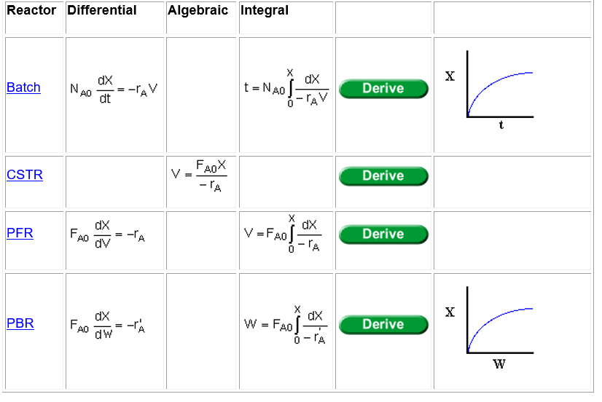
Fundamentals of CRE
Design Equations
The design equations presented in Chapter 1 can also be written in terms of conversion.
The following design equations are for single reactions only. Design equations for multiple reactions
will be discussed later.
Salah N. Farhan College of Engineering Diyala University

Slide 6
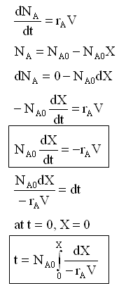
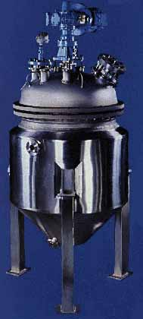
Fundamentals of CRE
Derivation of Batch Reactor Design Equations
Salah N. Farhan College of Engineering Diyala University

Slide 7
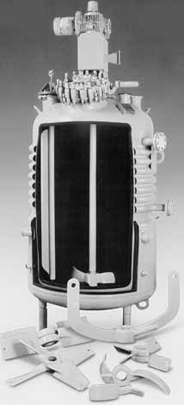
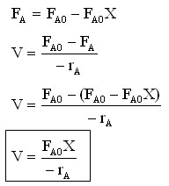
Fundamentals of CRE
Derivation of CSTR Design Equations
Salah N. Farhan College of Engineering Diyala University

Slide 8
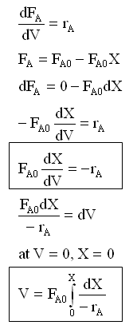
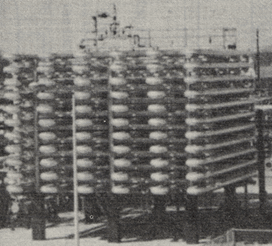
Fundamentals of CRE
Derivation of PFR Reactor Design Equations
Salah N. Farhan College of Engineering Diyala University

Slide 9
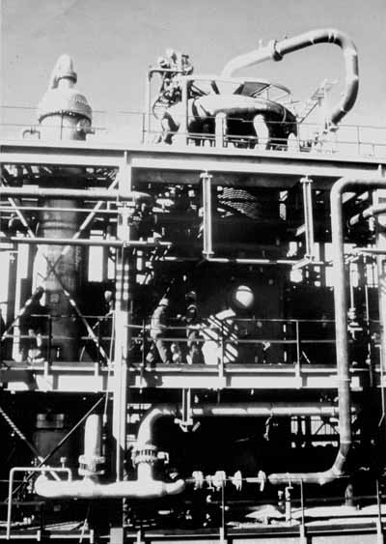
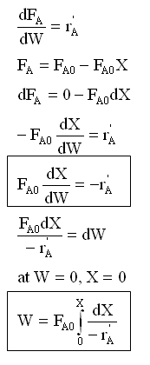
Fundamentals of CRE
Derivation of PBR Reactor Design Equations
Salah N. Farhan College of Engineering Diyala University

Slide 10
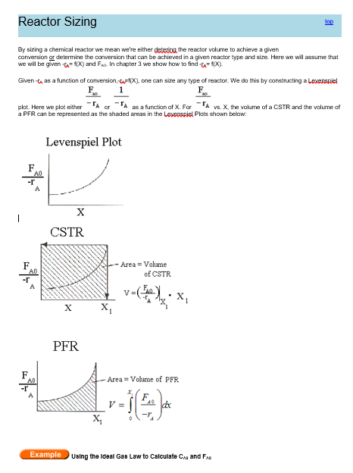
Fundamentals of CRE
Salah N. Farhan College of Engineering Diyala University

Slide 11
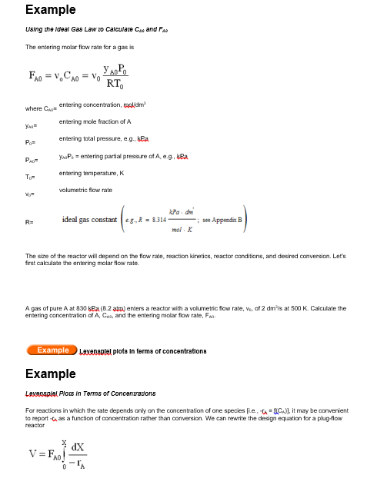
Fundamentals of CRE
Salah N. Farhan College of Engineering Diyala University

Slide 12

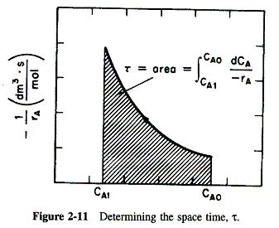


Fundamentals of CRE
in terms of the concentration, C_{A}, rather than in terms of conversion for the special case when v = v₀. We develop and discuss the following equation for space time and the figure below.
Example
Levenspiel Plots in Terms of Concentrations
For reactions in which the rate depends only on the concentration of one species
[i.e., -r_{A} = f(C_{A})], it may be convenient to report -r_{A} as a function of concentration rather than conversion.
We can rewrite the design equation for a plug-flow reactor
Salah N. Farhan College of Engineering Diyala University

Slide 13
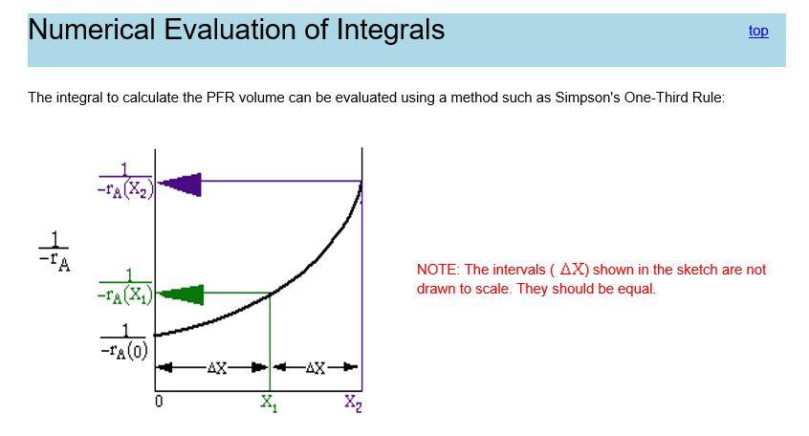
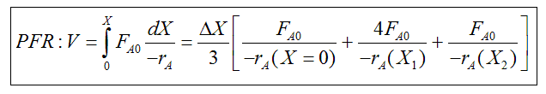
Fundamentals of CRE
Salah N. Farhan College of Engineering Diyala University

Slide 14
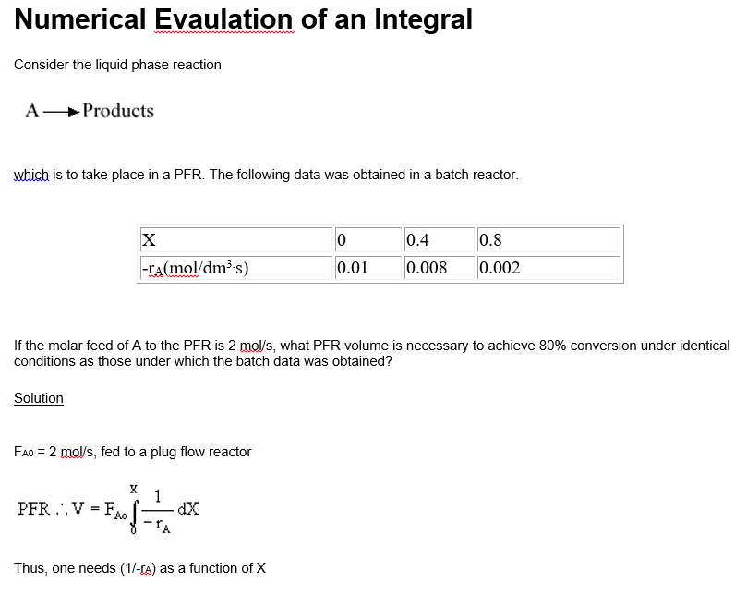
Fundamentals of CRE
Salah N. Farhan College of Engineering Diyala University

Slide 15
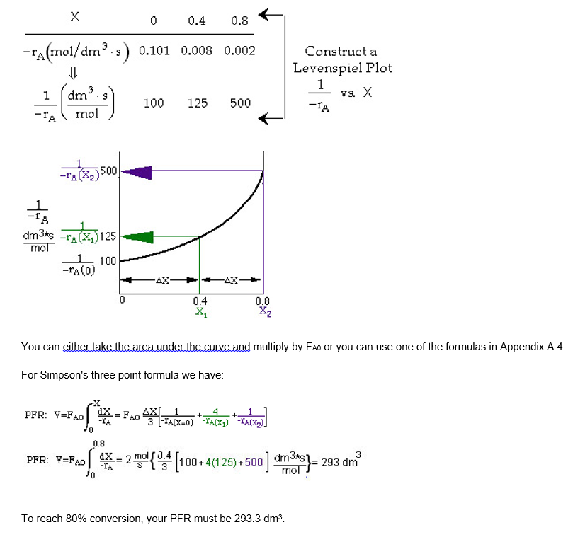
Fundamentals of CRE
Salah N. Farhan College of Engineering Diyala University

Slide 16
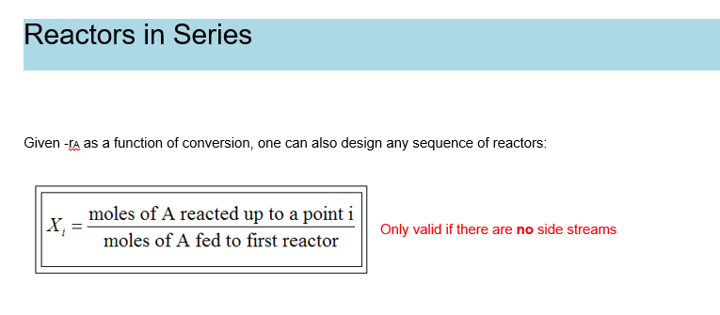
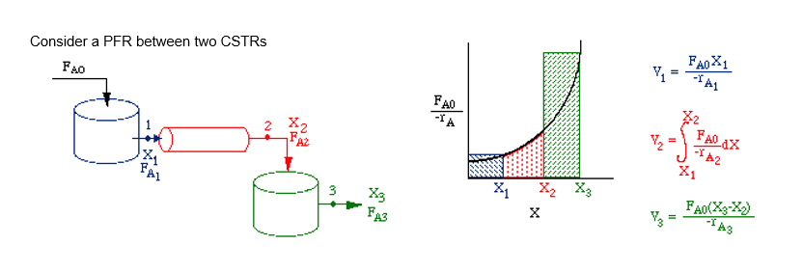
Fundamentals of CRE
Salah N. Farhan College of Engineering Diyala University

Slide 17
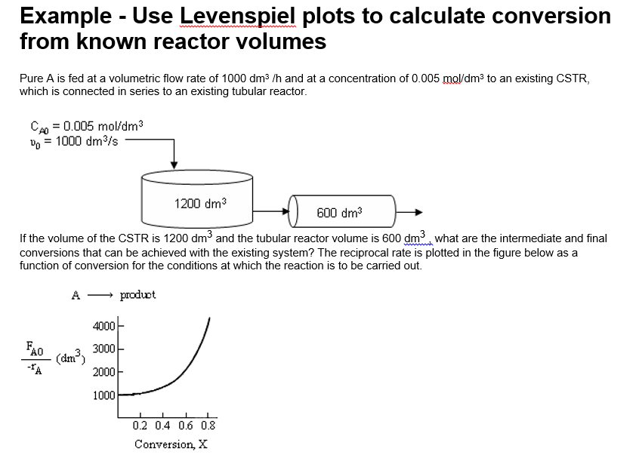
Fundamentals of CRE
Salah N. Farhan College of Engineering Diyala University

Slide 18
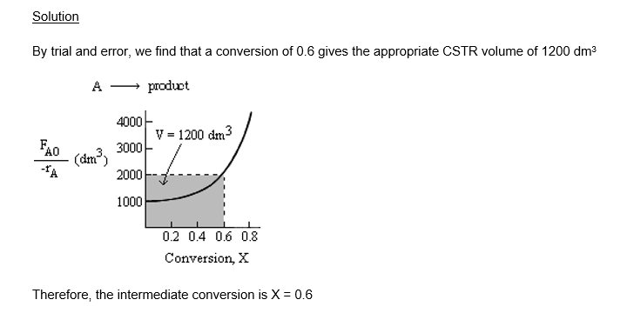
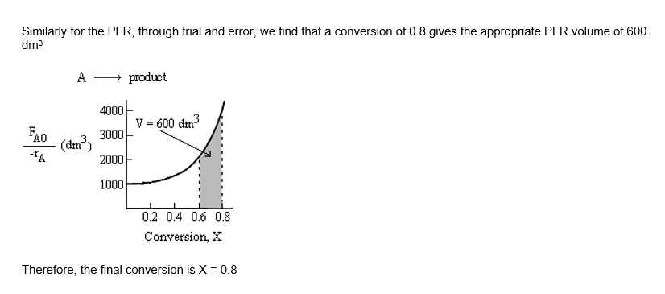
Fundamentals of CRE
Salah N. Farhan College of Engineering Diyala University

Slide 19
Fundamentals of CRE
Critical Thinking Question
The following are BAD examples of Critical Thinking Questions.
What specifically is the product?
While this question could be a CTQ from the clarification category, it is not a good critical thinking question because it is superficial and the information is about the product and is not relevant to solving for the conversion and reactor volumes as well as critiquing the answers.
Is the reactor really tubular or does it have some bulges in it?
This is not a good critical thinking question because we know in Chapter 1 that even if the reactor varies in cross sectional area the conversion-volume relationship is the same.
Other no so good critical thinking questions
Will this be on the exam?
What's the correct answers?
Why is there a "2" in this equation?
What are the units of this symbol?
While the last two questions are not CTQs, they may be valid questions.
Salah N. Farhan College of Engineering Diyala University

Slide 20
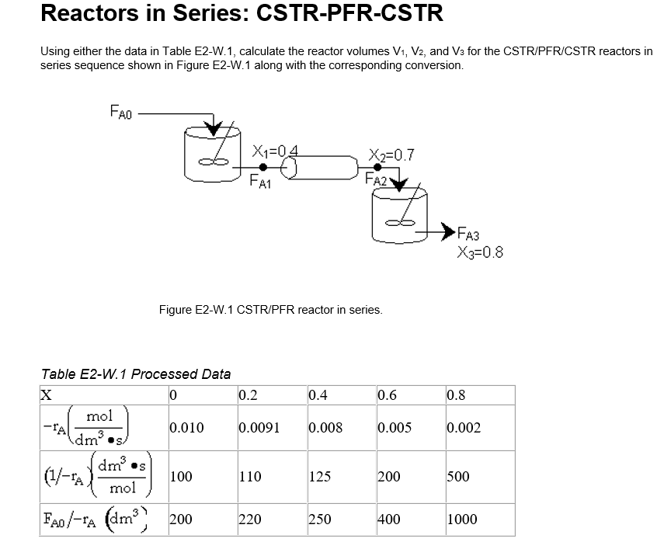
Fundamentals of CRE
Salah N. Farhan College of Engineering Diyala University

Slide 21
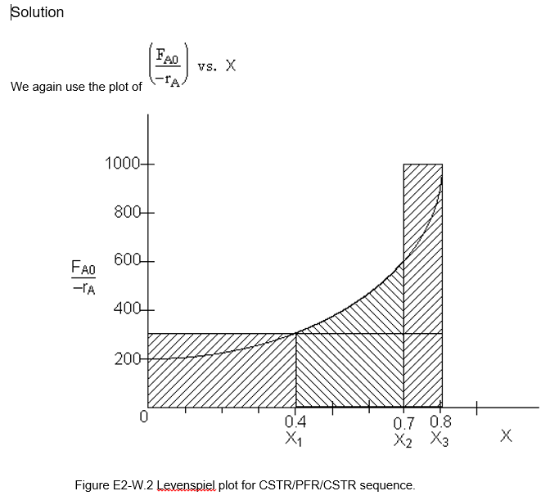
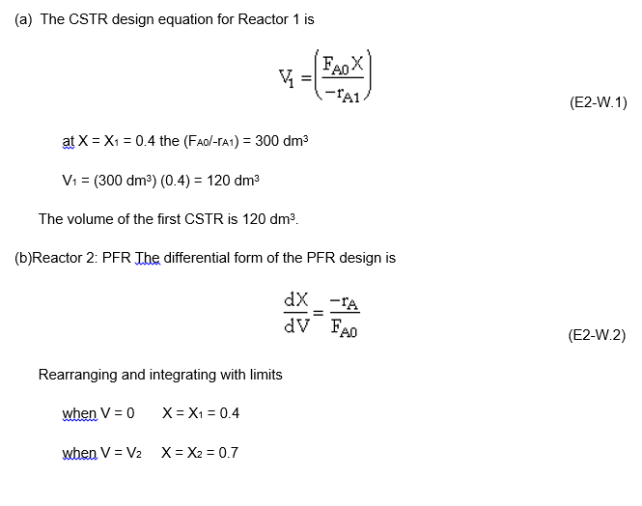
Fundamentals of CRE
Salah N. Farhan College of Engineering Diyala University

Slide 22
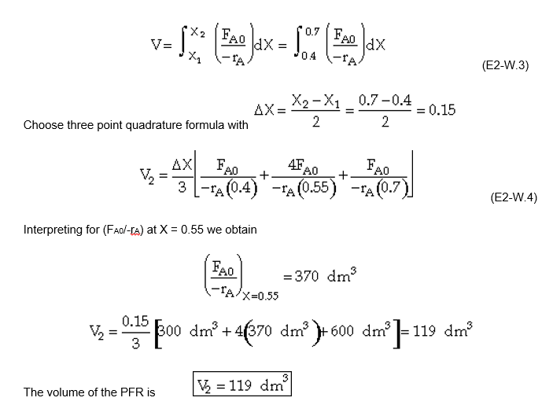
Fundamentals of CRE
Salah N. Farhan College of Engineering Diyala University

Slide 23
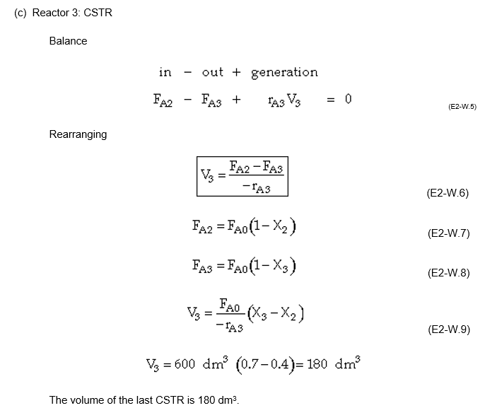
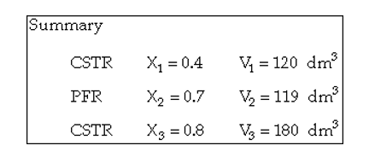
Fundamentals of CRE
Salah N. Farhan College of Engineering Diyala University

Slide 24
Fundamentals of CRE
Salah N. Farhan College of Engineering Diyala University

